Slide 1
Electrochemistry
Chapter 20

Slide 2
Electrolysis
Electrolysis is the use of electricity to bring about a chemical reaction.
Redox reactions occur at the electrodes.
At the cathode(-) a reduction reaction occurs (gain of electrons).
At the Anode(+) an oxidation reaction occurs (loss of electrons).

Slide 3
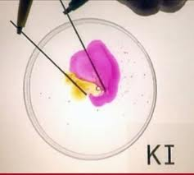
(1) Electrolysis of a solution of potassium iodide using inert electrodes
A few drops of phenolphthalein indicator is added to the solution.
Cathode Reaction
2H₂O + 2e-→ H₂ + 2OH⁻
This makes the solution alkaline.(*pink) due to alkaline ions
Anode Reaction
2I⁻ - 2e- → I₂ (Brown colour)
The brown colour is due to the production of Iodine at the anode.
The potassium ion is very stable and is not reduced(spectator ion)

Slide 4
(2) Electrolysis of acidified Water using inert electrodes (platinum)
Cathode Reaction
2H⁺ + 2e→ H₂
Anode Reaction
H₂O - 2e- → 2H⁺ + ½ O₂
Hydrogen gas is formed at the cathode while Oxygen is
formed at the anode.
Twice as much Hydrogen as Oxygen is formed.

Slide 5
Electrolysis of Sodium Sulfate (Na₂SO₄) using inert electrodes
A few drops of universal indicator are added to the solution.
At the cathode the solution becomes Blue and Hydrogen gas is produced
At the anode the solution becomes Red and Oxygen gas is produced.
Cathode Reaction
2H₂O + 2e-→ H₂ + 2OH⁻
This makes the solution alkaline.(*Blue)
Anode Reaction
H₂O - 2e- → 2H⁺ + ½ O₂
This makes the solution acidic(*Red)
Note: The Sodium and sulfate ions are very stable and are not oxidized or reduced. These are known as spectator ions.

Slide 6
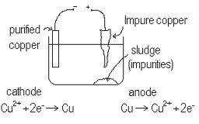
Electrolysis of a solution of Copper Sulphate with copper electrodes.
Cathode Reaction
Cu²⁺ + 2e- → Cu
Anode reaction
Cu - 2e- → Cu²⁺
Pure Copper is deposited at the cathode
The impure copper at the anode dissolves.
Used to purify copper for the electronics industry.

Slide 7
Electroplating
Electroplating is a process where electrolysis is used to put a layer of one metal on the surface of another.
Electroplating is the transfer of one metal, acting as an anode, onto the surface of another piece of metal, acting as the cathode in an electrolytic cell. A solution of a salt of the metal being transferred is used as the electrolyte. The metal being transferred is usually more precious, or of more pleasing appearance, or more resistant to corrosion, than the metal on to which it is deposited. Silver medals are sometimes gold plated, steel framed bicycles are chrome plated, cutlery is nickel plated, etc. Nickel metal is resistant to corrosion and has a good lustrous appearance. It is therefore a good metal for use in electroplating metals that are more prone to corrosion. Chrome plate gives a very corrosive-resistant bright shiny finish to steel alloy. It was widely used on automobile trim and is used in bathroom fittings. Chrome plate consists of a layer of about 0.3 mm thick of chromium metal deposited over a layer of nickel on the steel.

Slide 8
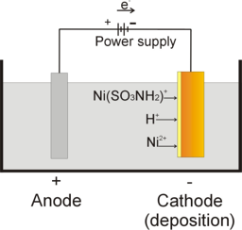
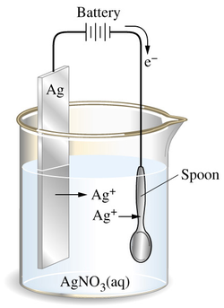

Slide 9
The Electrochemical Series
The Electrochemical Series is a list of elements in order of their standard electrode potentials.
Standard electrode potentials are obtained by measuring the voltage when the half cell is connected to a Hydrogen electrode.

Slide 10
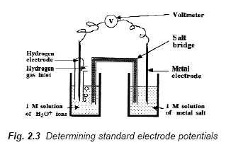
Determining standard electrode potentials

Slide 11
Galvanic cell

Slide 12
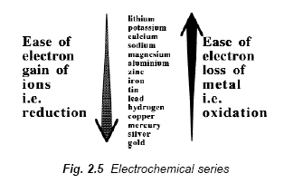
Electrochemical series

Slide 13
Use of the electrochemical series
The electrochemical series helps to predict displacement reactions in solution.
It is found that a metal will displace another metal below it in the electrochemical series.
Mg + Cu²⁺ --> Mg²⁺ + Cu
Zn + CuSO₄ --> ZnSO₄ + Cu
(Zn + Cu²⁺ --> Zn²⁺ + Cu )

